Slide 1

Week 2 Wed.
Recap from Monday:
--power of law to determine the population of a nation
--power of representation, media, and racial belief in influencing public policy
Today:
--Asian American demographics:
class and education disparities based on modes of entry to the US
--model minority stereotype: origins and effects
--Volunteers? Share family story: For post 1965 immigration, which category [family reunification, refugeeism, h 1b- occupation] brought you to the US?

Slide 2


Slide 3
Linking the impact of the laws to our class demographics
Stand if you or your family migrated to the U.S. from Asia or the Pacific Rim (Asian Americans or Asians in U.S.). International students from Asia should also stand.
Sit down if you or your family came to the U.S. AFTER 1965.
On the basis of reading Ancheta or your knowledge of history, why the difference?

Slide 4
What did our classroom demo reveal?
All but one Asian/Asian American families entered after 1965:
Lasting impact of Exclusion Laws:
1. power of law to determine the (racial) population of a nation; Asian exclusion as largely successful
2. power of a racial belief system to influence law and public policy: “Yellow Peril”
To think about for sections:
Where do we see the notion of the “Yellow Peril” resurfacing in contemporary culture in ways that extend Ono and Pham’s examples?

Slide 5
Immigration Act of 1965 as a “watershed” moment for Asian populations in the US (Ancheta, p. 19)
removed “explicit racial and national origin categories from the law” and reopened immigration from Asia, with a quota of 20,000 for each country and privileging
family reunification
occupational categories
“humanitarian” admissions through a “refugee” category

Slide 6
Asian American demographics
from “How ‘Crazy Rich’ Asians Have Led to the Largest Income Gap in the U.S.,” Hassan and Carlsen:
relatively recent emergence of Asian American populations
b. class division within it based on modes of entry

Slide 7
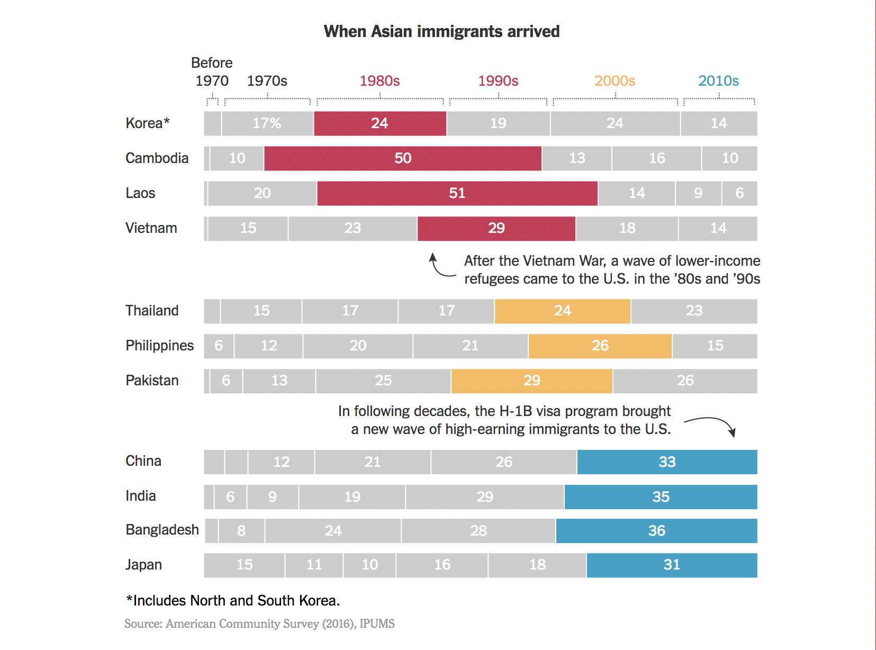
From: “How ‘Crazy Rich’ Asians Have Led to the Largest Income Gap in the U.S.”Hassan and Carlsen Asian American demographics: a. relatively recent immigration

Slide 8
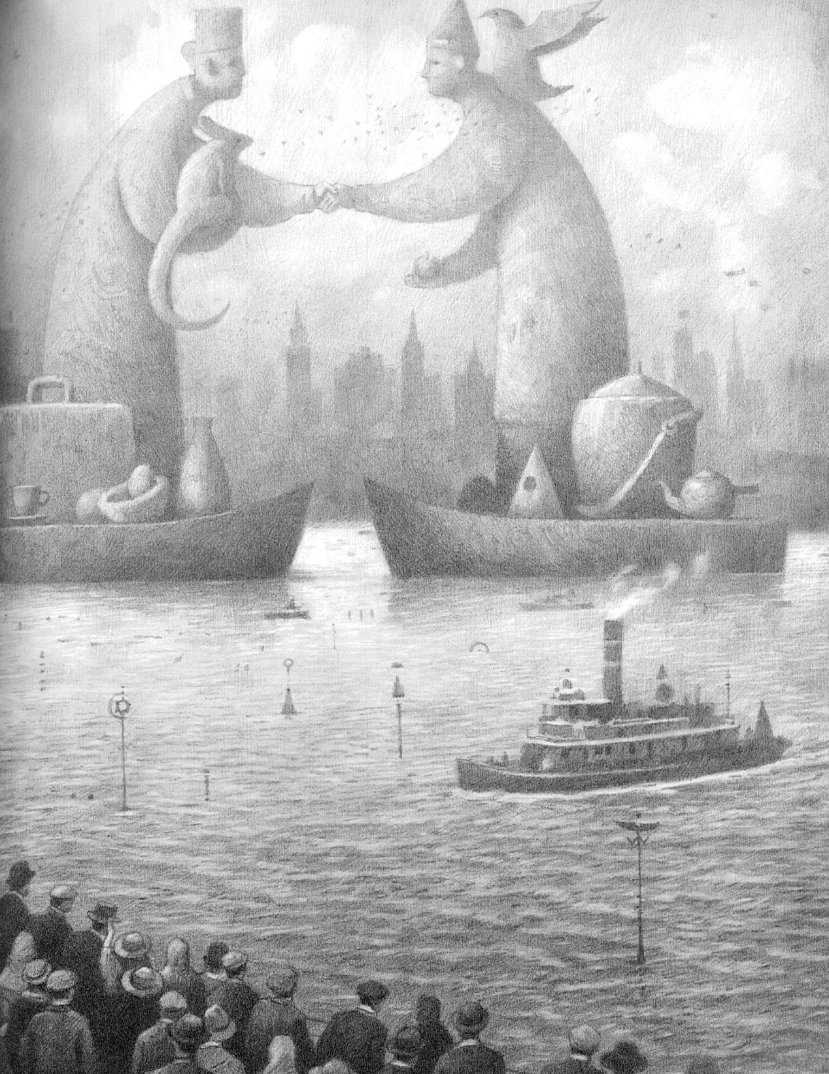
Exploring the diversity of Asian America in this class
Volunteers?
Share family story about immigration.
Where are you or your family from?
What year did you come to the U.S. and why?
family reunification
occupational categories
“humanitarian” admissions through a “refugee” category

Slide 9
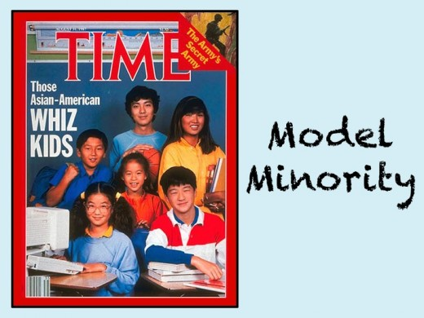
Raise your hand if someone in your Asian/American family entered the U.S. via an occupational category.
Volunteers:
Did you or someone in your family enter the U.S. on a h1b visa?
What discipline, profession, or job?

Slide 10
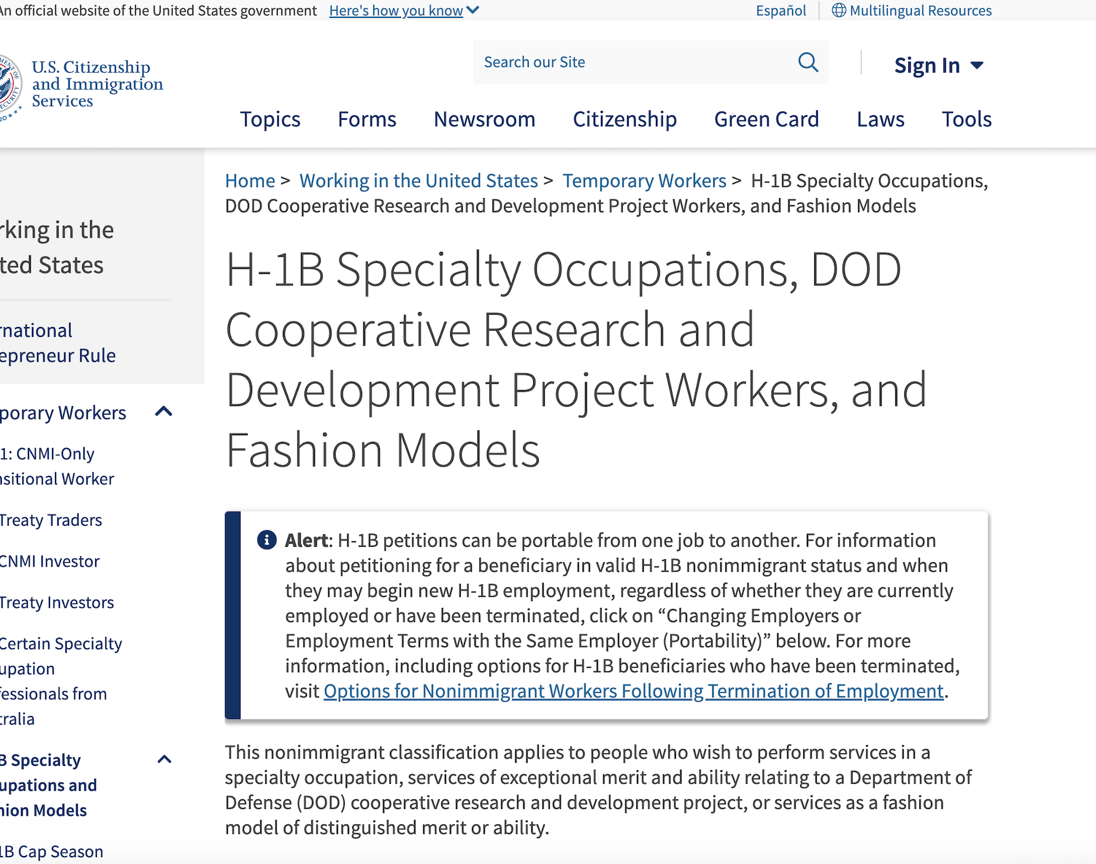
Entry to US after 1965: H-1B Visa privileging occupations
Work that requires:
highly specialized knowledge
bachelor's or higher degree in the specialty
H-1B specialty occupations may include
engineering, medicine and health, mathematics, physical sciences
social sciences, architecture, education, law
business, accounting
theology, the arts.

Slide 11
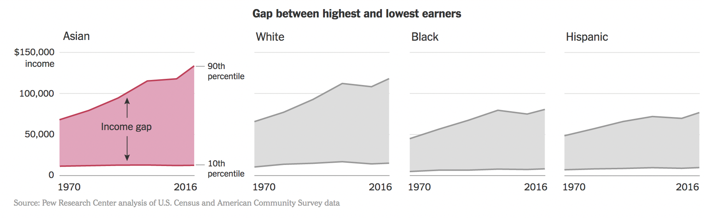
b. class divisions, income gap within “Asian America” In 2009, Asian immigrants admitted on the basis of 63% family unification 21 % refugee status 16 % “skilled” workers, selective occupational categories:

Slide 12
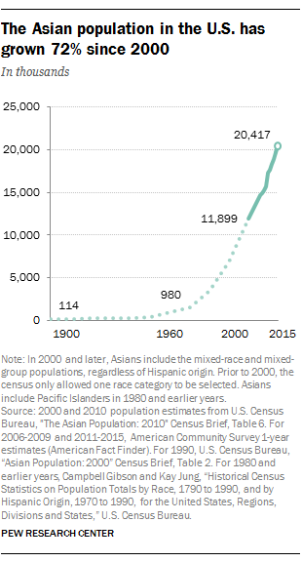
“The Rise of Asian Americans” Pew Research Center, 2012
“Asian Americans are the highest income, best-educated and fastest growing racial group in the United States.”

Slide 13
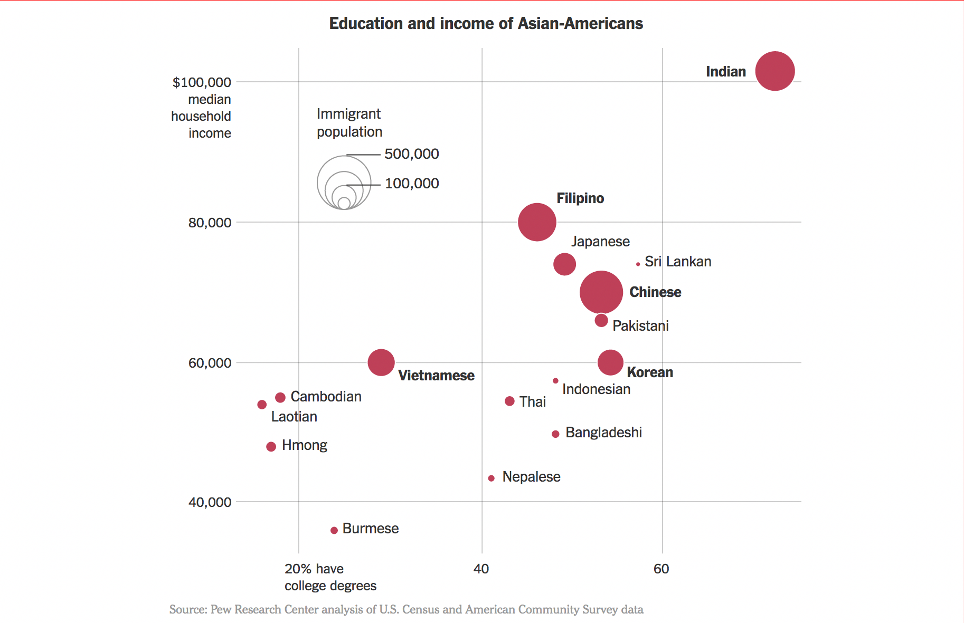
Disaggregating data on “Asian American” income and education: Which side do you look at to generalize Asian/America?

Slide 14
“How did the status of a group once considered unassimilable, undesirable immigrants and the ‘yellow peril’ change so dramatically in the twentieth century? . . . .
[T]he answer lies in part in the change in selectivity of contemporary Asian immigration”
(Lee and Zhou, 115-116).

Slide 15
Disaggregating data on “Asian American” income and education: Which side do you look at to generalize Asian/America?

Slide 16
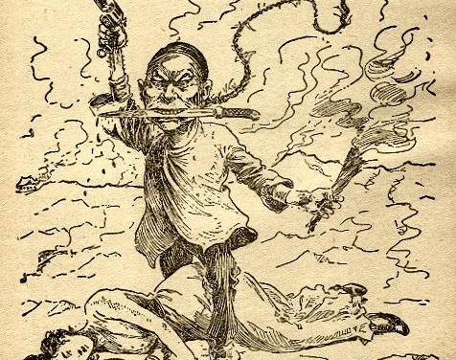
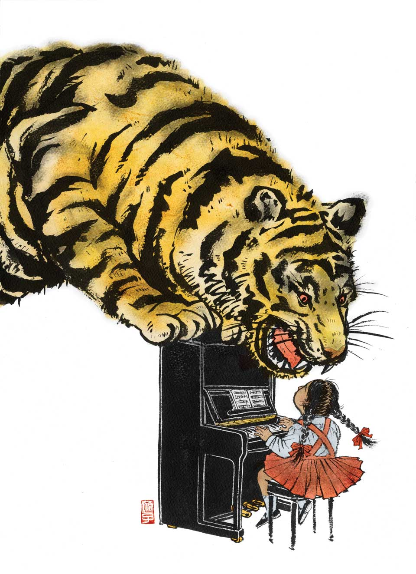
“Stereotypes are widely held, oversimplified, fixed images or ideas of particular groups.”
(Lee and Zhou, p. 123)

Slide 17
”model minority” based on selectivity of data plus:

Slide 18
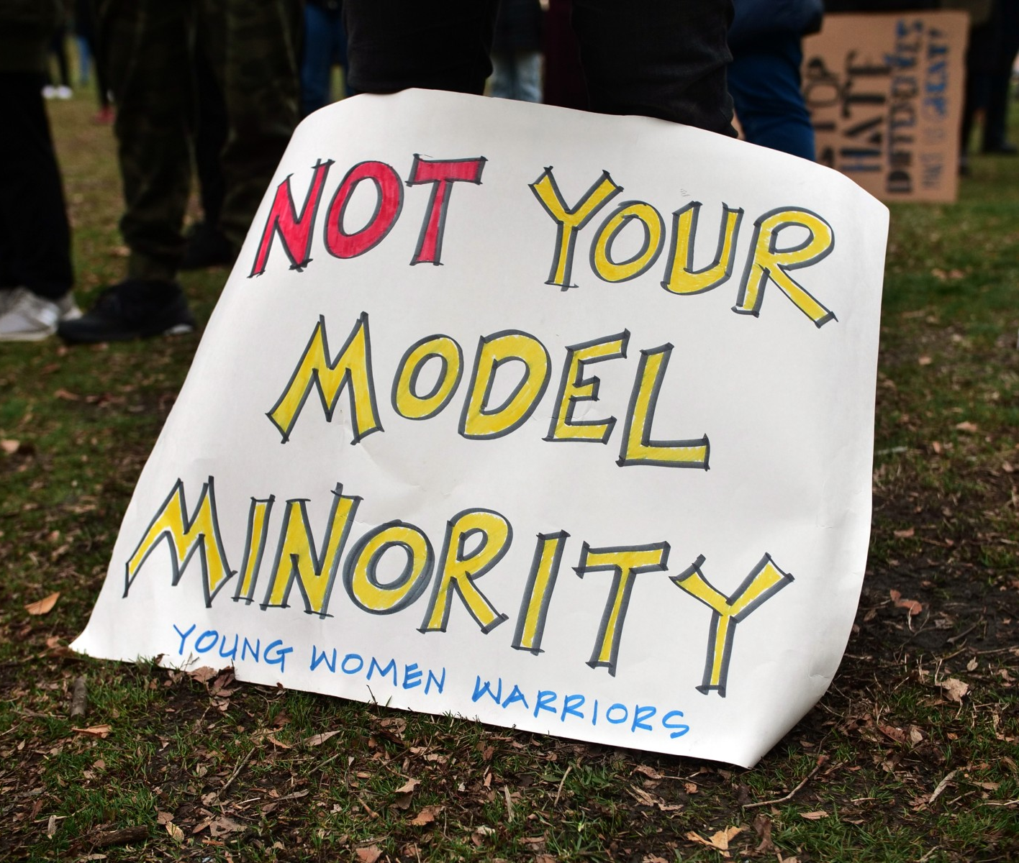
Lee and Zhou on using selective information to support the “success frame” of achievement in ethnic communities:
“First, the model minority stereotype places undue pressure on Asian Americans to excel academically, resulting in feelings of abject failure if they do not or cannot fit the narrowly defined success frame.
Those who fall outside the Asian American exceptionalism construct respond by rejecting their ethnoracial identity, claiming that they are ‘not like other Asians’ or ‘not the typical Chinese’” (136).

Slide 19
To think about for section from video, “A Conversation With Asian-Americans on Race: What resonated for you in any of these testimonies? Does any of the reading for this week illuminate the experiences shared here?
Next week read:
By Mon:
“Microaggressions and the Asian American Experience,” Sue
“Confirming and Disconfirming Stereotypes,” Lee and Zhou
“Young Children’s Thinking About Ethnic Differences,” Ramsay
View Media: “Peanut Butter, Jelly and Racism,” Reshamwala
By Wed.:
“The Name Jar,” Choi
“Yoko,” Wells

Slide 20
The model minority stereotype
Journalist Malcolm Gladwell:
“Go to any Western college campus and you’ll find Asian students have a reputation for being in the library long after everyone else has left.
Sometimes people of Asian background get offended when their culture is described this way, because they think that the stereotype is being used as a form of disparagement. But a belief in work ought to be a thing of beauty.”
from Outliers: The Story of Success (2008) (p.239)
Is this a compliment?

